Slide 1

Investigate Common Sources Of Noise During Image Acquisition, Analyze Their Effects On Image Quality
GUIDED BY:
Mrs.R.C. Jeni Gracia
NAME:Tejanvesh Reddy
REG.NO:192425156

Slide 2
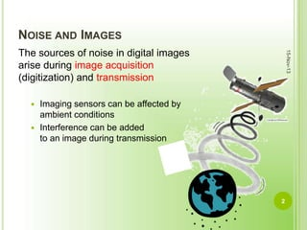
Introduction to Image Acquisition Noise
Noise in image acquisition refers to unwanted variations that degrade the visual quality of an image.
Understanding the sources of noise is essential for improving image clarity and accuracy.
This presentation explores common noise sources and their impact on image quality.
Notes:
Image source: https://image.slidesharecdn.com

Slide 3
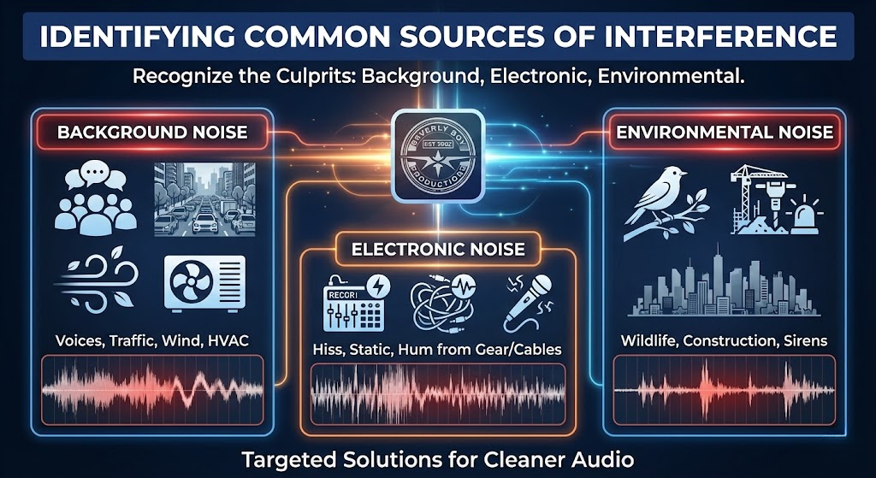
Electronic and Sensor Noise
Electronic noise originates from the inherent imperfections in the imaging sensor's electronic circuitry.
Sensor noise is influenced by temperature, sensor quality, and exposure settings.
This type of noise often appears as graininess or random speckles in images.
Environmental and External Sources
External factors like ambient lighting fluctuations can introduce variability in captured images.
Electromagnetic interference from nearby devices can cause signal disruptions.
These environmental noises can result in inconsistent brightness and color distortions.
Notes:
Image source: https://www.slidemake.com

Slide 4
Quantization and Compression Artifacts
Quantization noise occurs during analog-to-digital conversion, leading to loss of detail.
Lossy compression techniques can introduce blockiness and blurring artifacts.
Both types of artifacts diminish image sharpness and can obscure important details.
Notes:
Image source: https://www.researchgate.net

Slide 5
Effects of Noise on Image Quality
Noise reduces the overall clarity, making it difficult to interpret fine details.
It can obscure important features necessary for accurate analysis or diagnosis.
Excessive noise can lead to misinterpretation and reduce the reliability of image-based decisions.
Notes:
Image source: https://www.researchgate.net

Slide 6
Conclusion and Mitigation Strategies
Recognizing noise sources allows for targeted strategies to minimize their effects.
Techniques such as optimal sensor selection, proper lighting, and post-processing help reduce noise.
Continuous advancements in imaging technology are improving image quality despite inherent noise challenges.
Notes:
Image source: https://www.researchgate.net

